Slide 1
GreenComp
GREEN COMP
COMPETENCE AREAS
is a reference framework for sustainability competences.
is part of the policy actions by EU set out in the European Green Deal
identifies a set of sustainability competences -knowledge, skills and attitudes - that promote ways to think, plan and act with empathy, responsibility, and care for our planet.
See the documents:
https://ec.europa.eu/jrc/en/greencomp
https://ec.europa.eu/jrc/en/greencomp/greencomp-conceptual-reference-model
COMPETENCES
KNOWLEDGE, SKILLS AND ATTITUDES
K
S
A
K
A
K
A
A
K
A
K
A
K
S
K
A
K
S
A
S
S
S
K
S
S
K
S
A
S
A
A
S
K
A
S
K
Notes:
(This slide explains the background and the whole of GreenComp.)
The development of a European sustainability competence
framework is one of the policy actions set out in the European
Green Deal as a catalyst to promote learning on environmental
sustainability in the European Union. GreenComp
identifies a set of sustainability competences to feed into
education programmes to help learners develop knowledge,
skills and attitudes that promote ways to think, plan and act
with empathy, responsibility, and care for our planet and for
public health.
This work began with a literature review and drew on several
consultations with experts and stakeholders working in the
field of sustainability education and lifelong learning. The results
presented in the report form a framework for learning
for environmental sustainability that can be applied in any
learning context. GreenComp
is designed to be a non-prescriptive reference for learning
schemes fostering sustainability as a competence.
The picture here explains how the main competence areas cover definitions of knowledge, skills and attitudes that are essential for this specific competence.

Slide 2
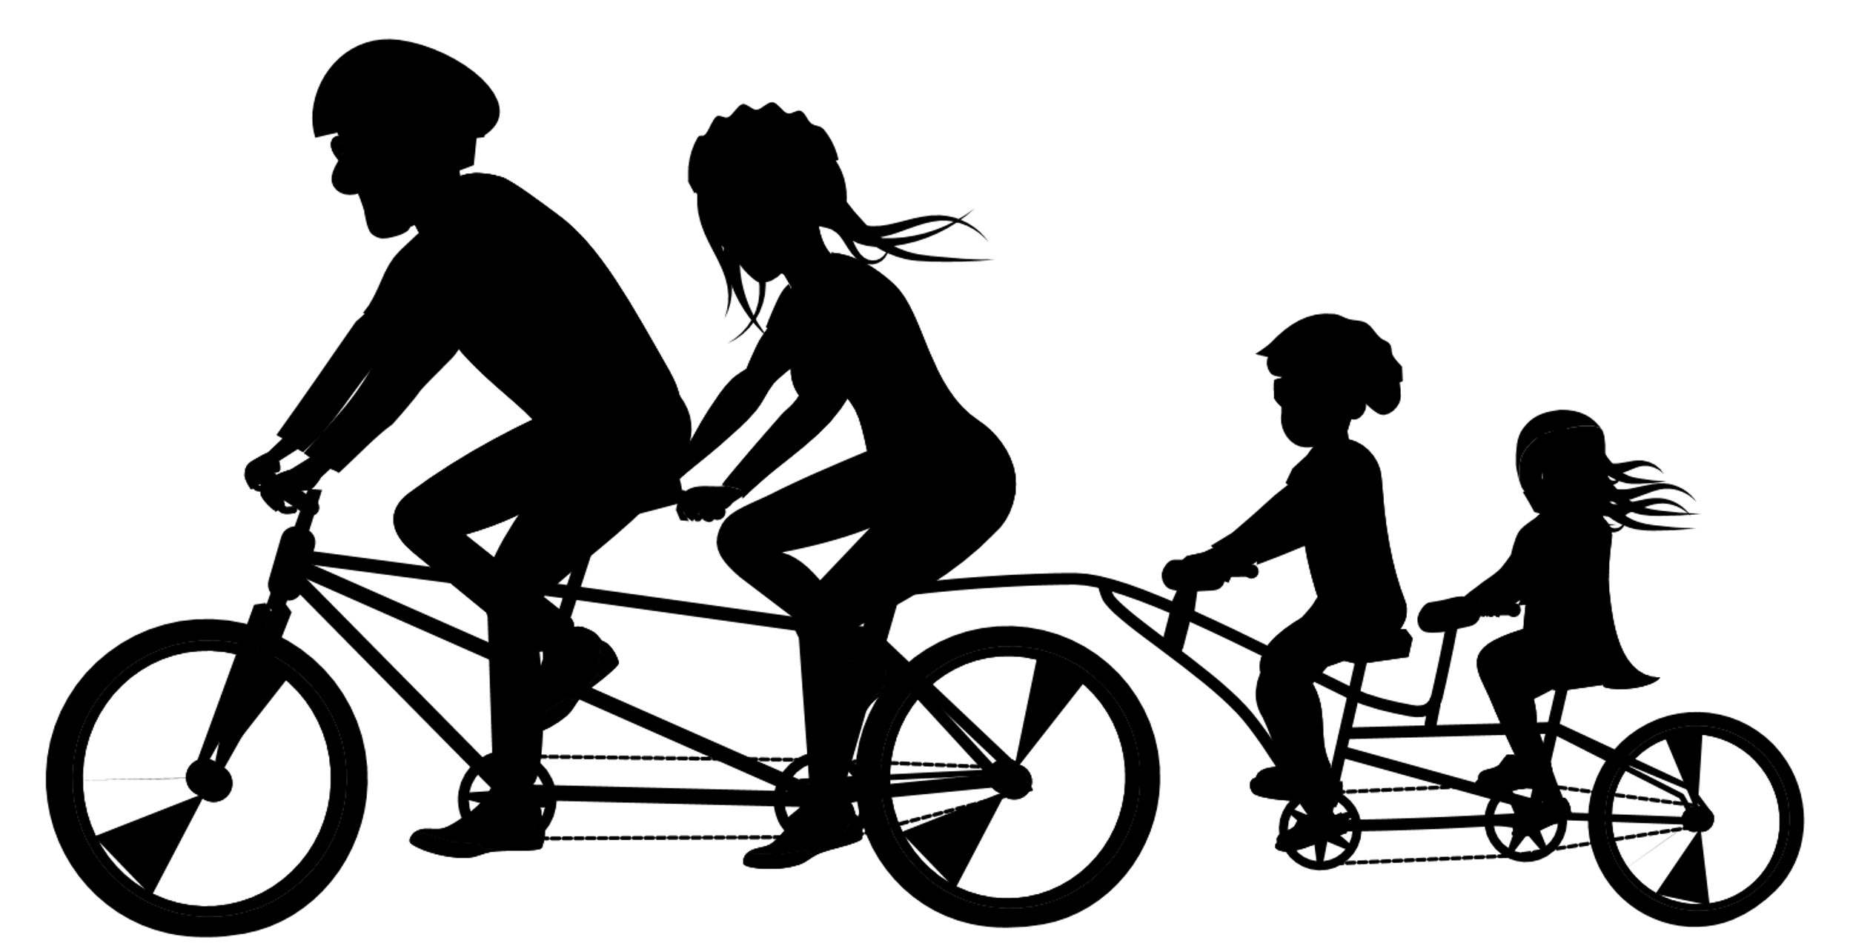
GREENCOMP
FUTURES LITERACY
VALUING
SUSTAINABILITY
ADAPTABILITY
ENVISIONING
FUTURES
EMBODYING VALUES
SUPPORTING
FAIRNESS
EXPLORATORY THINKING
PROMOTING NATURE
INDIVIDUAL INITIATIVES
SYSTEMS THINKING
EMBRACING
COMPLEXITY
COLLECTIVE ACTION
ACTING
CRITICAL THINKING
POLITICAL
AGENCY
PROBLEM FRAMING
Notes:
(You can choose what kind of illustration you use, when you present GreenComp. This illustration made by Finnish ECF4CLIM-team. Another option for illustration is in the slide 22)
Here you can see how GreenComp comprises four interrelated competence areas: ‘embodying sustainability values’, ‘embracing complexity in
sustainability’, ‘envisioning sustainable futures’ and ‘acting for sustainability’.
Sustainability as a competence encompasses all four competence areas taken together. Besides, each area comprises three competences that are interlinked and equally important. In essence GreenComp implies that
sustainability as a competence is made of 12 building blocks.
Thus, all the competence areas are interconnected. For example, valuing nature is based to systems understanding, how human well-being is dependent on nature’s well-being and well-being of ecosystems and how economy, society and environment are interconnected. Critical thinking and problem framing are essential for motivating and engaging people in acting. Envisioning sustainable futures is relevant for framing the goal and the problem. Exploratory thinking is needed for finding creative and successful ways to act.
For younger students
European framework for sustainability competences could be demonstrated and exemplified through an image of a dream school
If promoting sustainability competences of GreenComp framed the goals of a dream school:
In the dream school students are actively involved in or participate on promoting sustainability and work together for visions of a sustainable future. They value nature and are aware of how human well-being is connected to nature’s well-being and the well-being of ecosystems. The students and teachers critically identify together unsustainable practices in their community, envision alternative sustainable future and are empowered to act for sustainability.
Background – how to illustrate GreenComp
The illustration of this slide is one way to explain and illustrate sustainability competences. In the official GreenComp document you can find the illustration with a metaphor of bee pollination. You can also find “Use Cases” at the end of the official document, after references of GreenComp, two stories that concretize the sustainability competences. The first “Use case” is about a teacher committed to sustainability education and describes what kind of competences she needs when aiming at collective action for cleaning a river with students and locals and politicians. The other story is about a high school student and his initiatives at the school and in the community.

Slide 3
1. Embodying sustainability values
These slides with more specific expressions of Green Comp are not necessary to use, but these are here just in case you want to use them.
Valuing sustainability: To reflect on personal values; identify how values vary among people and over time, while critically evaluating how they align with sustainability values.
Supporting fairness, equity and justice for current and future generations and learn from previous generations for sustainability.
Promoting a nature: humans are part of nature; and respect the needs and rights of other species and of nature itself in order to restore and regenerate healthy and resilient ecosystems.
EMBODYING VALUES
Notes:
The competence area ‘Embodying sustainability values’
> Valuing sustainability encourages us to reflect on and challenge personal values and world-views in terms of unsustainability: whether our way of thinking, our plans, and actions cause any harm and are in line with sustainability values and thus contribute to sustainability. Valuing sustainability implies also identifying how values vary among people and over time. Thus, its primary aim is not to teach specific values, but make learners realize that values are constructs and people can choose which values to prioritize in their lives³
> Supporting fairness refers to advocating equity and justice for current and future generations and learning from previous generations for sustainability.
> Promoting nature means the view of humans being part of nature; and to respect the needs and rights of other species and of nature itself in order to restore and regenerate healthy and resilient ecosystems. Promoting nature is about developing empathy towards the planet and showing care for other species. This requires knowledge about the main parts of the natural environment (geosphere, biosphere, hydrosphere, cryosphere and atmosphere)
Promoting nature fosters a feeling of connectedness that can help contrast the psychological distress and negative emotions that children and young people worldwide experience because of climate change and thus can help improve their mood and mental health.

Slide 4
2. Embracing complexity in sustainability
Systems thinking: To approach a sustainability problem from all sides; to consider time, space and context in order to understand how elements interact within and between systems: interconnectedness of economy, society and environment.
Critical thinking: To assess information and arguments, identify assumptions, challenge the status quo, and reflect on how personal, social and cultural backgrounds influence thinking and conclusions.
Problem framing related to difficulty, people involved, time and geographical scope, in order to identify suitable approaches to mitigating and adapting to already existing problems in which everybody is involved.
EMBRACING
COMPLEXITY
Notes:
Embracing complexity in sustainability’ is about:
- empowering learners with systemic and critical thinking and problem framing skills. It encourages people to reflect on how to better assess information and challenge unsustainability;
System thinking means scanning systems by identifying interconnections and feedback; For example, how economy, society and environment are interconnected.
Critical thinking refers to assessing information and arguments, identifying assumptions, challenging the status quo, and reflection on how personal, social and cultural backgrounds influence thinking and conclusions
Framing challenges as sustainability problems helps us learn about the scale of a situation while identifying everyone involved.
EXTRA how to explain systems thinking
Systems thinking can be understood as a tool for evaluating options, decision-making and taking action⁴³. It is based on the assumption that parts of a system act differently, when taken apart from the system. In fact, contrary to this, fragmentary thinking, i.e. analysing parts in isolation, instead of the whole interconnected system, increases short-termism and could led to an oversimplification of sustainability problems which may not correspond to reality. Equipping learners with systems thinking is necessary to understand complex sustainability problems and their evolution.

Slide 5
3. Envisioning SUSTAINABLE futures
Futures literacy: To envision alternative sustainable futures by imagining and developing alternative scenarios and identifying the steps needed to achieve a preferred sustainable future
Adaptability: To manage transitions and challenges in complex sustainability situations and make decisions related to the future in the face of uncertainty, ambiguity and risk
Exploratory thinking: To adopt a relational way of thinking by exploring and linking different disciplines, using creativity and experimentation with novel ideas or methods
ENVISIONING
FUTURES
Notes:
The competence area ‘Envisioning sustainability futures’ enables learners to visualzse alternative future scenarios and identify actions to achieve a sustainable future. ‘Adaptability’ refers to a competence of coping with uncertainty about the futures and trade-offs in sustainability. Applying creative and transdisciplinary approaches to our way of thinking can foster a circular society and encourage learners to use their imagination when thinking about the future
>Future literacy covers a competence to envision alternative sustainable futures by imagining and developing alternative scenarios and identifying the steps needed to achieve a preferred sustainable future.
>Adaptability means a competence of managing transitions and challenges in complex sustainability situations and make decisions related to the future in the face of uncertainty, ambiguity and risk.
>Exploratory thinking means adopting a relational way of thinking by exploring and linking different disciplines, using creativity and experimentation with novel ideas or methods.

Slide 6
4. Acting for sustainability
Political agency: To navigate the political system, identify political responsibility and accountability for unsustainable behaviour, and demand effective policies for sustainability
Collective action: To act for change in collaboration with others
Individual initiative: To identify own potential for sustainability and to actively contribute (to improving prospects) for the community and the planet
ACTING
Notes:
Acting for sustainability encourages learners to take action at individual and collective level to shape sustainable futures, to the extent possible. It also invites learners to demand action from those re
sponsible to make change happen.
>Political agency covers competences of navigating the political system, identifying political responsibility and accountability for unsustainable behaviour, and demand effective policies for sustainability.
>Collective action means simply a competence to act for change in collaboration with others.
>Individual initiative refers to competences of identifying own personal potential for sustainability and to actively contribute to improving prospects for the community and the planet.

